Slide 1

Discovering Nulls and Outliers DS-1004 Big Data Advisor: Prof. Juliana Freire
Minimizers
Diogo Mesquita Mihir Rana Kenil Tanna
https://github.com/ranamihir/big_data_project

Slide 2
INTRODUCTION
Problem Statement:
Null Value Detection
Outlier Detection
Univariate outliers
Multivariate outliers
Data Set Collection:
NYC Open Data
50 data sets

Slide 3
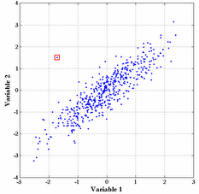
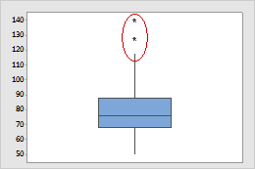
PROBLEM FORMULATION
Data Cleaning
"$1.99“ → 1.99, "1,000“ → 1000, 10003 → “10003” (zip code)
Missing Value Treatment
“None”, “N/A”, “ “, “-”, “-999”, “999”, etc.
Outliers
Source: link
Source: link

Slide 4
METHODOLOGY
Clean Data
Identify Data Type
Find and Remove Nulls
Find Univariate Outliers
Remove by Voting
Find Multivariate Outliers
Remove by Voting

Slide 5
OUTLIER DETECTION
Nearest Neighbor based
DBSCAN
Clustering based
k-Means
Mixture of Parametric Distributions
Gaussian Mixture Models

Slide 6
OUTLIER DETECTION
Non-Parametric
Histogram / frequency – based
Statistical Anomaly based
Box plot Rule
Gaussian model based (z-score)
Other Probabilistic models (Beta, Gamma, etc.)

Slide 7
KEY STRENGTHS
End-to-end automated framework
Box plot Rule at core
No input specific to particular data set / column required
Robust
Multiple techniques optimizing different metrics
Voting / Intersection of multiple similar techniques
Efficient
Remove univariate outliers before finding multivariate ones

Slide 8
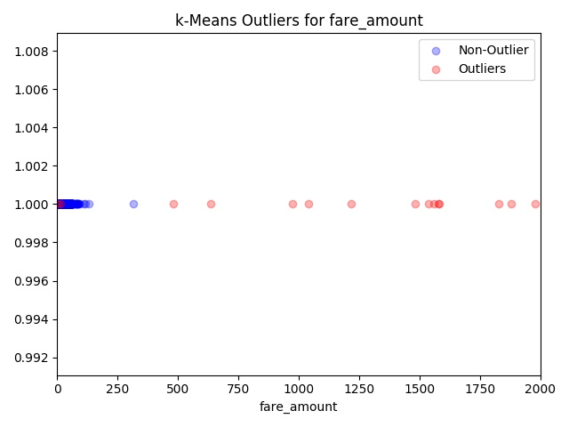
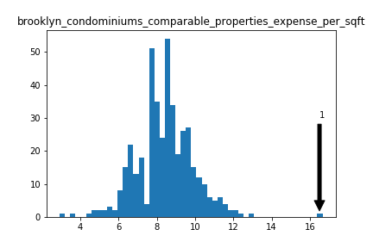
RESULTS
Summary | num_level_3
count | 5302
Mean | 239.776
stddev | 267.144
min | 0.0
max | 2020.0
rid | num_level_3
847 | 1386.0
851 | 1434.0
963 | 1337.0
990 | 1344.0
1493 | 1522.0
Column | Value
brooklyn_ condominiums_ comparable_ properties_ address | “5 UNKNOWN”
Data: usap-qc7e.tsv
Data: bss9-579f.tsv

Slide 9
REFERENCES
Jason Brownlee. 2016. How To Handle Missing Values In Machine Learning Data With Weka. (Jun 2016). https://machinelearningmastery.com/ how-to-handle-missing-values-in-machine-learning-data-with-weka/
Varun Chandola, Arindam Banerjee, and Vipin Kumar. 2007. Anomaly Detection: A Survey. (2007).
Google. 2018. Locate Outliers, Google Cloud Dataprep Documentation, Google Cloud. (2018). https://cloud.google.com/dataprep/docs/html/Locate-Outliers_ 57344572
Ming Hua and Jian Pei. 2007. Cleaning Disguised Missing Data: A Heuristic Approach. In Proceedings of the 13th ACM SIGKDD International Conference on Knowledge Discovery and Data Mining (KDD ’07). ACM, New York, NY, USA, 950–958. https://doi.org/10.1145/1281192.1281294
Ming Hua and Jian Pei. 2008. DiMaC: a disguised missing data cleaning tool. In KDD.
Sridhar Ramaswamy, Rajeev Rastogi, and Kyuseok Shim. 2000. Efficient Algorithms for Mining Outliers from Large Data Sets. SIGMOD Rec. 29, 2 (May 2000), 427–438. https://doi.org/10.1145/335191.335437

